Slide 1


Online Tutor
Finder System
By- Aditi Goyal (1900290110006 , CSI)
Anjali Singh (1900290110014 , CSI)

Slide 2
INTRODUCTION
The system of private tuition has been in existence in India for a long time but in recent times it has grown manifold affecting the very core of educational system.
We have created an online tutor finder system that will search a tutor as per your requirement & in your locality. We provide a direct contact between you and your tutor.
All the qualified individuals can easily pursue tutoring through our website. This website will be very effective for student , tutors and parents. We have tried our best to make our website (GROW WITH GURU )very effective & easy for all.

Slide 3


Slide 4
FEATURES
This system will help you to find tutors from nearby locations.
Teachers can also get student’s request just by logging into the website and setting up the profile.
Tutor’s qualification and credentials will be easily accessible to students.
One can read as well as write a blog.
1 week Demo class available for students.
Help students & every single individual who want to pursue tutoring as their part time job.

Slide 5
ENTITIES
ADMIN-
Admin can login, manage tutor by adding new teachers and updating their profiles.
Admin can also check for the registered students or tutors .
Admin can share credentials to tutors & students by Email.
Admin can respond to complains if any.
STUDENTS-
Students can register and login to view the tutors .
Students can select the tutor and after selecting will raise the request of demo lecture. Later finalize the teacher.
TUTOR-
Tutor can login by using credentials which will be provided by mail.
They can check for the request for demo lecture and accept the request. They can also check the booking done

Slide 6
Register on Grow With Guru
1
After login ,you will be directed to new homepage with more features.
2
Search for tutors by using various filters.
4
All the credentials of the tutor will be shared.
Create your profile
3
You can write or view a blog
5

Slide 7

Before Login

Slide 8

After Login

Slide 9
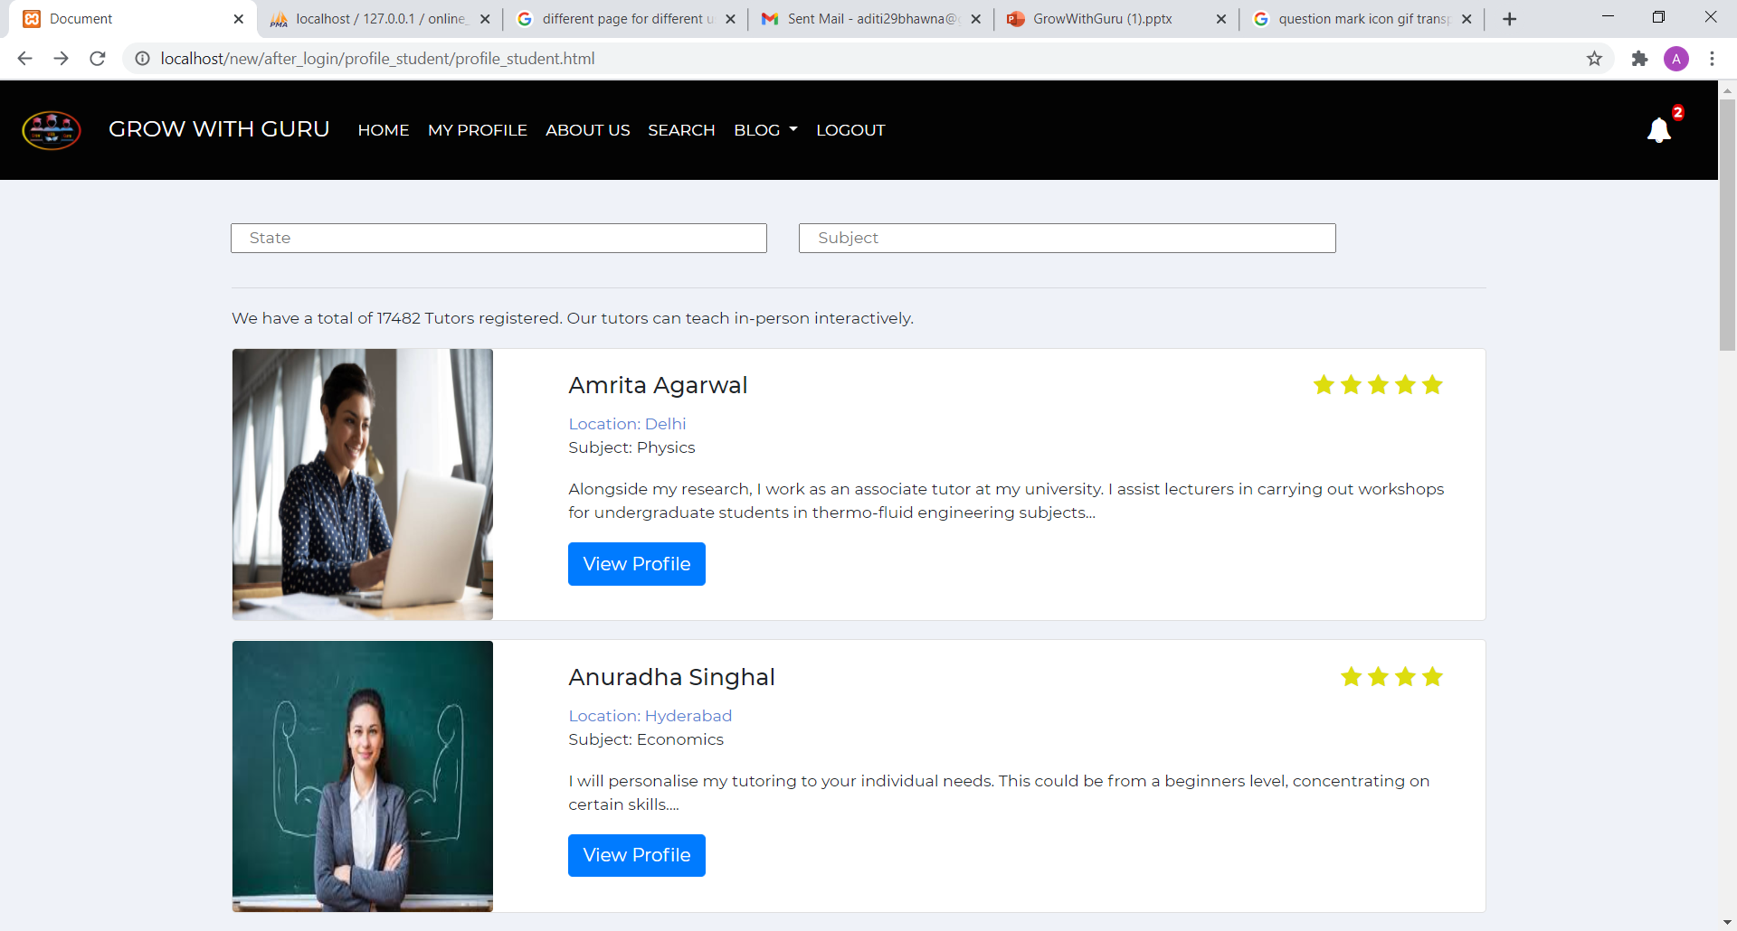
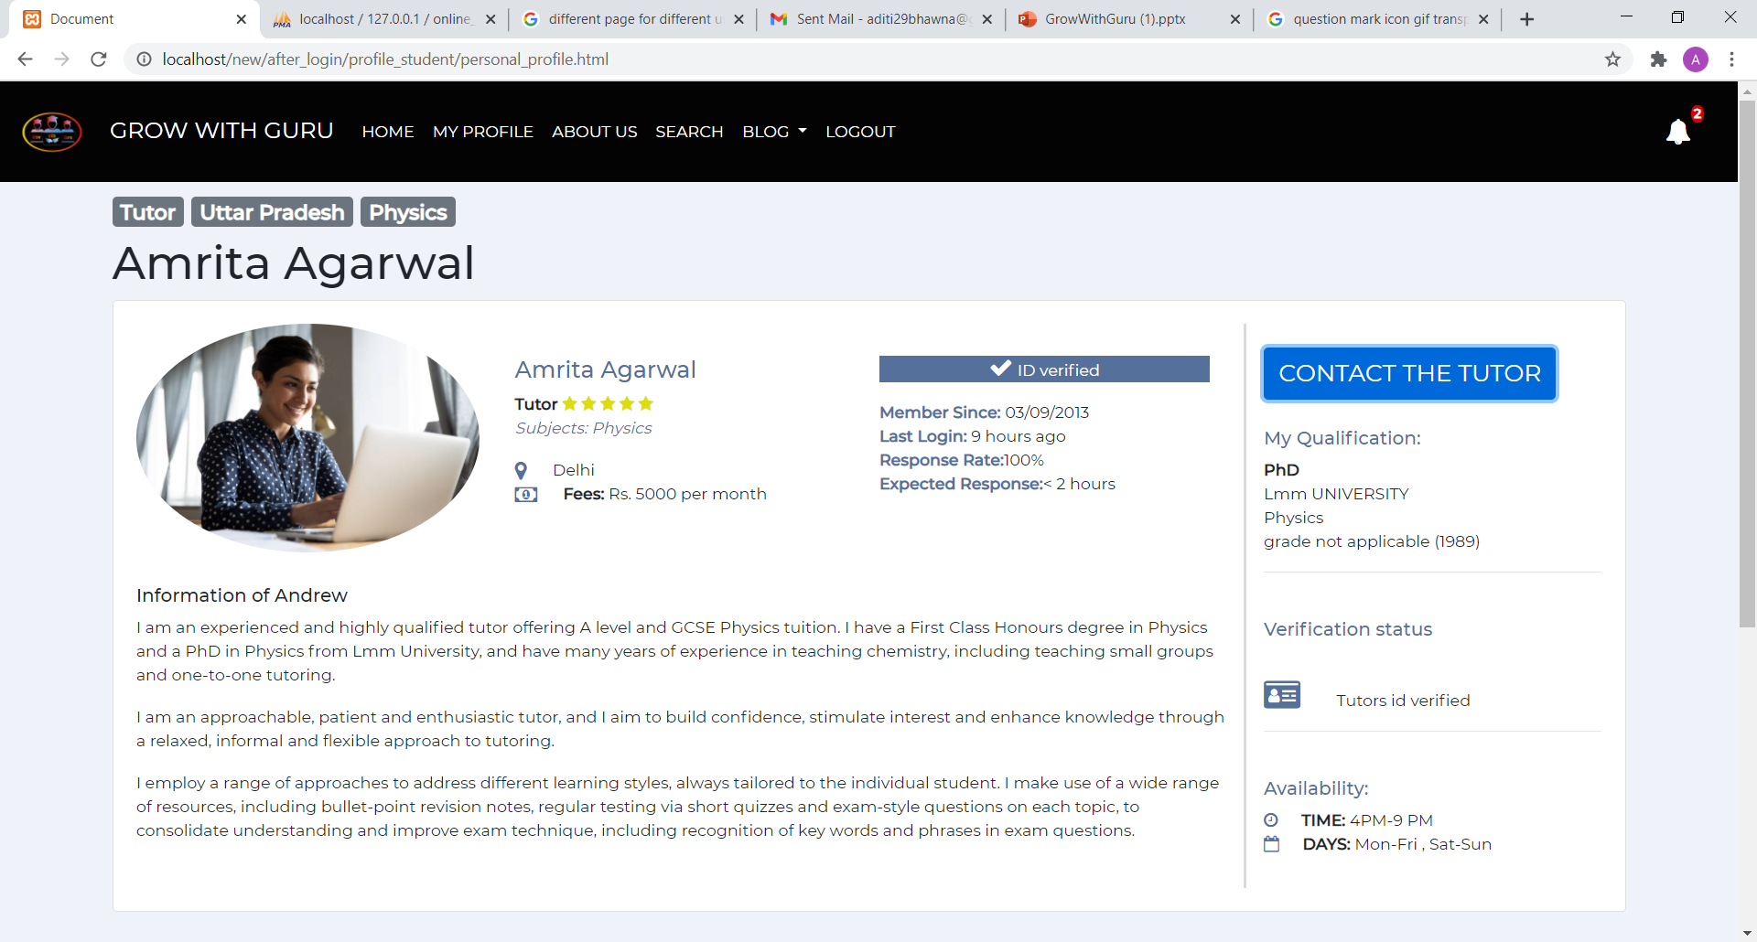
Searching the tutor

Slide 10
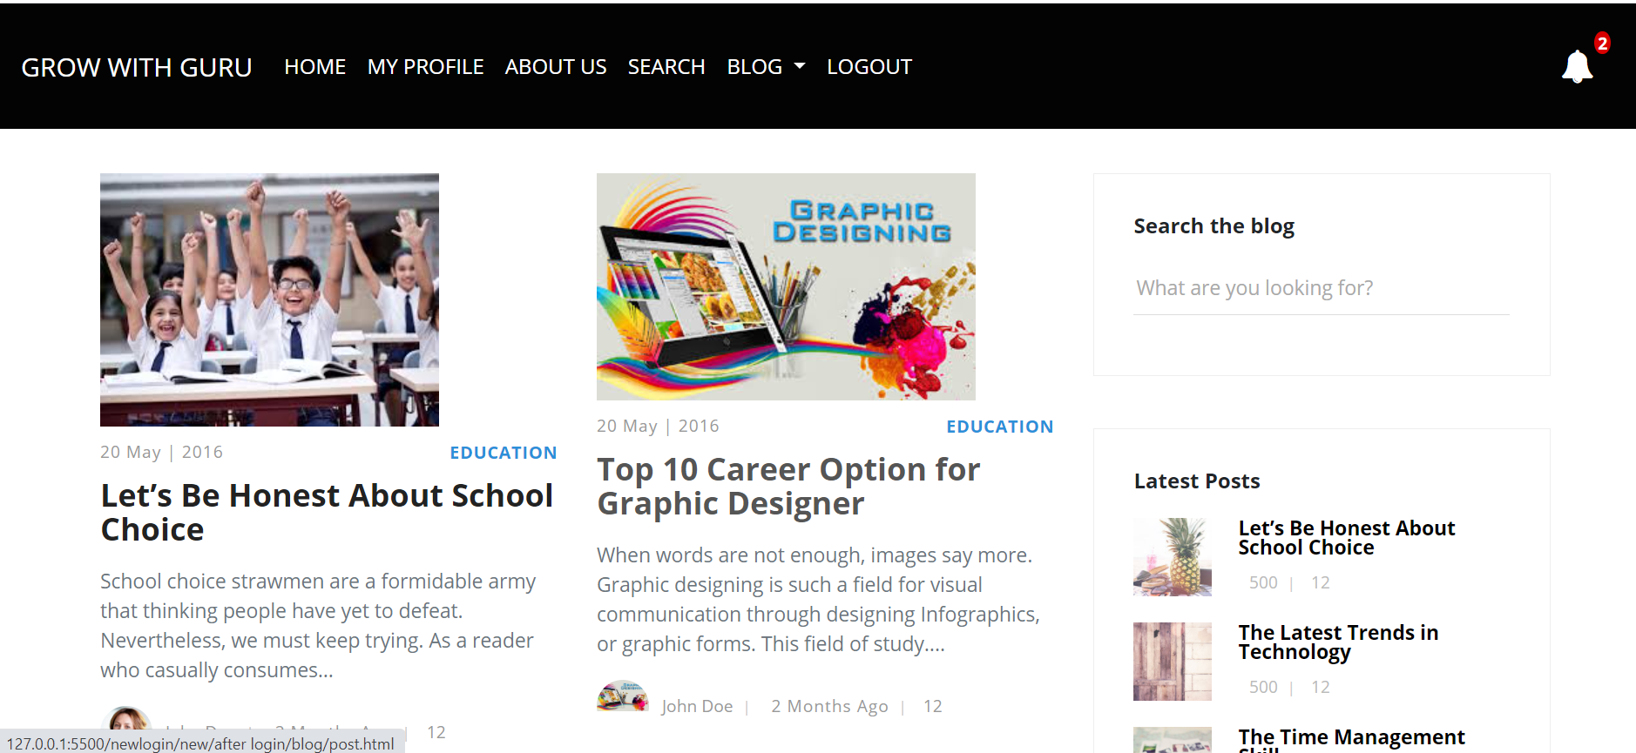
BLOG

Slide 11
LANGUAGES USED
HTML
CSS
JAVA
SCRIPT
BOOT
-STRAP
PHP
MY SQL

Slide 12
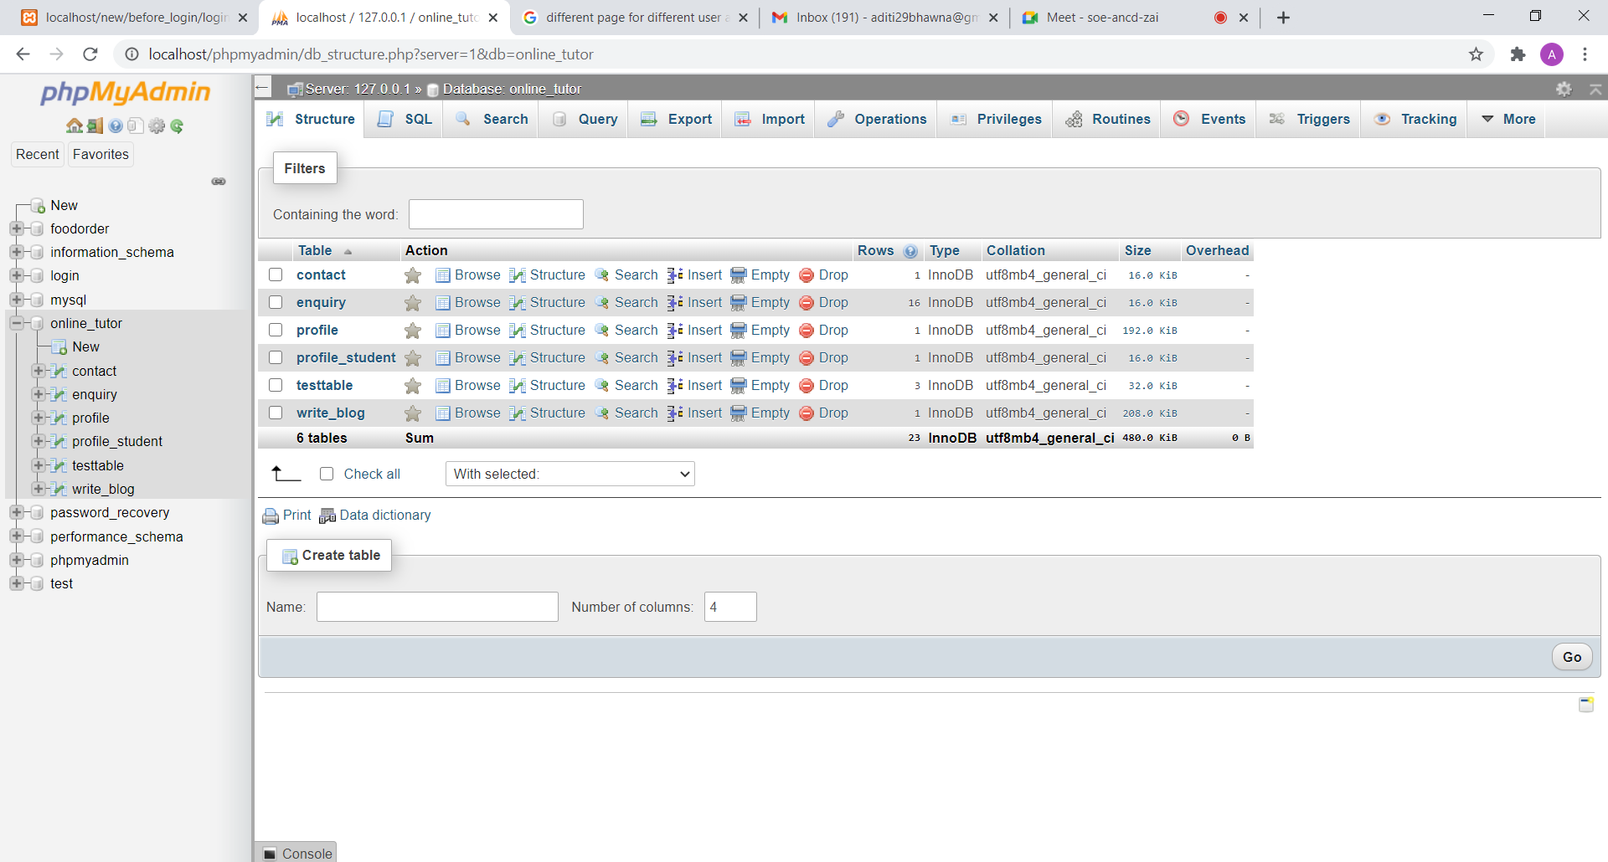
XAMP DATABASE

Slide 13

Why to prefer online tutor finder when online tutoring websites are already available ?
A Proper Network connection all the time is a big challenge.
It's easier to ensure students are paying attention.
A proper assessment of a student can be done when students & tutors are face to face.
Proper doubt clearing.
A disciplined student life is maintained.
Tutor can connect emotionally & a friendly atmosphere is maintained.

Slide 14
Future scope
Maintaining daily record of students & teachers.
Fee reminders.
A proper section will be made for requesting tutors.
Content will be provided online.
Online assessment examination.

Slide 15
Project Timeline
20 August | 10 September | 17 September | 1 October | 8 October | 22 October | 29 October | 11 November | 26 November | 3 December | 17 December | 24 December
Task 1
20 Days
HOME PAGE
Task 2
4 days
LOGIN &SIGNUP
Task 3
5 days
ABOUT US
6 days
PROFILE FRONTEND
Task 4
Task 5
5 days
Profile with Php & database
Task 6
7 days
BLOG
Task 7
10 days
SEARCH PAGE
Task 8
10 days
Backend
Project start
We’re here
Project end

Slide 16
THANK YOU

